Slide 1
Database Systems
COMP 3010E FALL 2025
Lecture 11 Physical model

Slide 2
Agenda
Storage Media
Representation of Databases on Disks
Buffer Management
Indexing

Slide 3
Goal of Physical Design
Purpose–translate the logical description of data into the technical specifications for storing and retrieving data
  Select what designs to use in your database
Goal–create a design for storing data that will provide adequate performance and ensure database integrity, security, and recoverability

Slide 4
Logical Design vs. Physical Design
Logical Design:
  Provide a systematic structure to data storage
  Reduce redundancy in data storage
  Avoid anomalies and improve integrity of data
Physical Design
  Improve performance
    e.g., faster access, optimal size
  Enhance security
  Easy backup and recovery
Before you implement your database using SQL

Slide 5
Key Design issues
Choosing Suitable Data Types
Optimize your table design
File organization and Indexing
Optimize your SQL queries

Slide 6
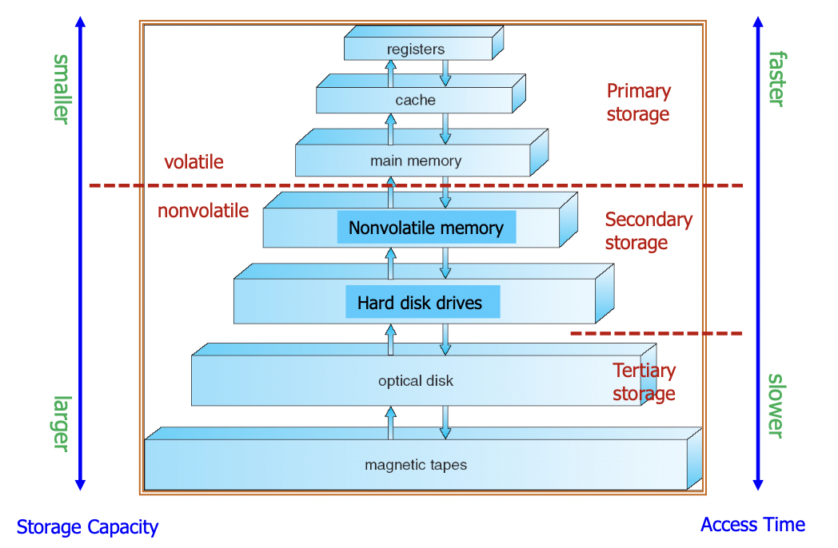
Storage Hierarchies of Computer
Data stored on Hard Disk - Won’t lose after power off
Load data into RAM for processing
Data may not fit in RAM
Data transfer units:
Cache ←→ RAM: Cache line, 64B
RAM ←→ HDD: Block/page, 512B-16KB
HDD ←→ Tertiary Storage: Block/page, 512B-16KB

Slide 7
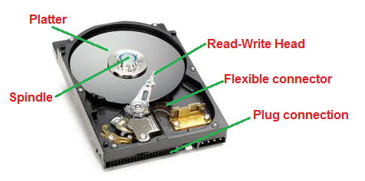
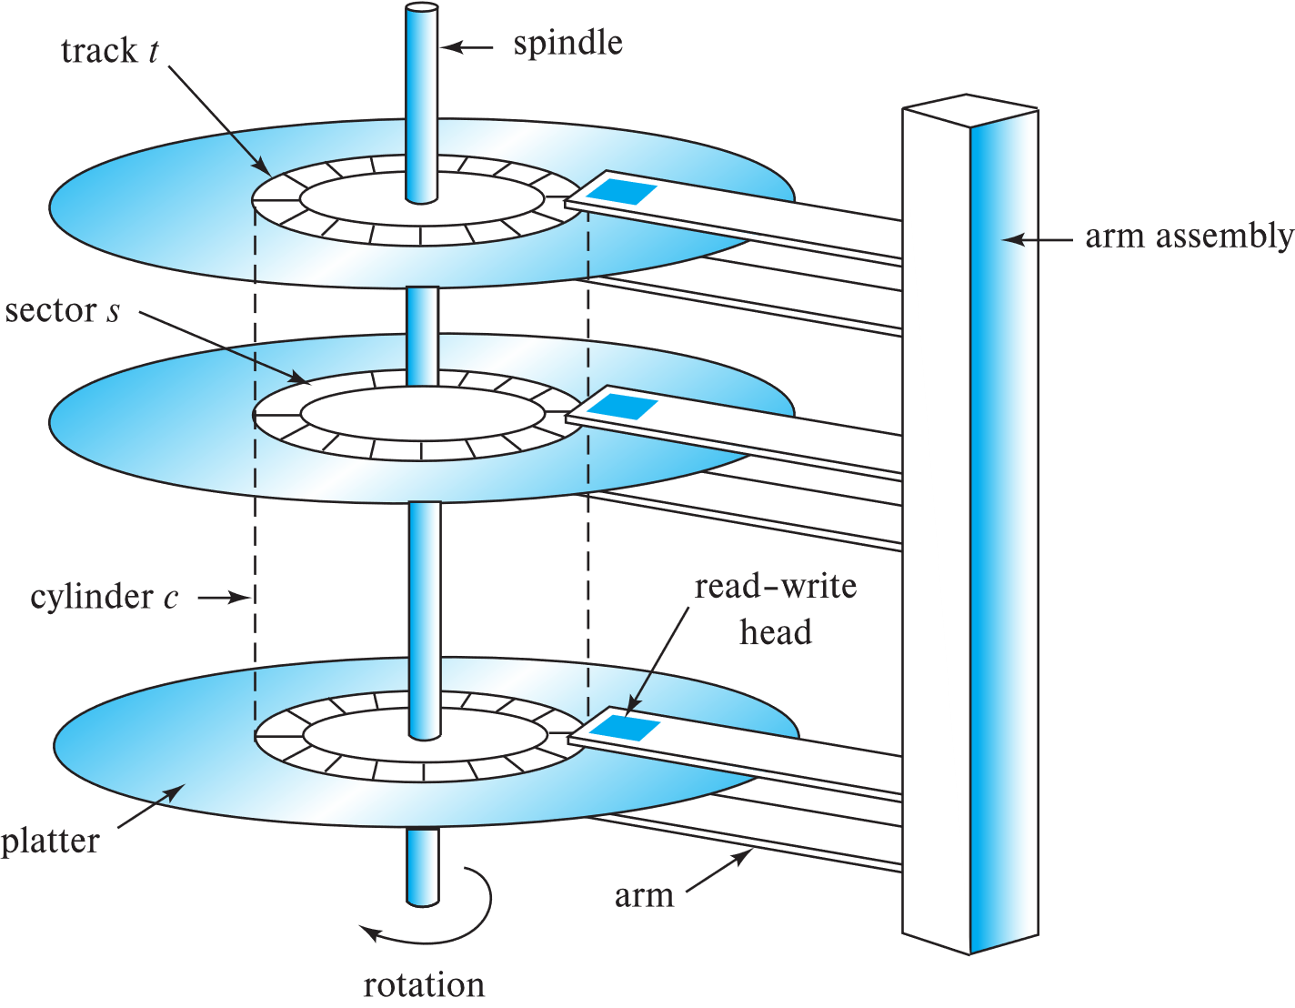
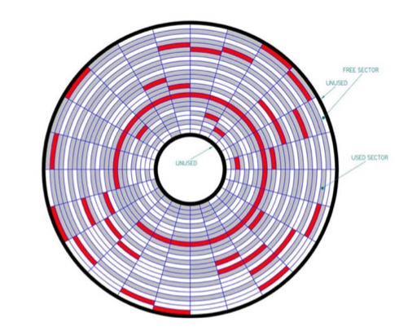
Storage Structure of Database
Traditional Magnetic Disk
Read/Write much slower than RAM
Sequential Read/Write faster than Random Read/Write
Sector (512 bytes)

Slide 8
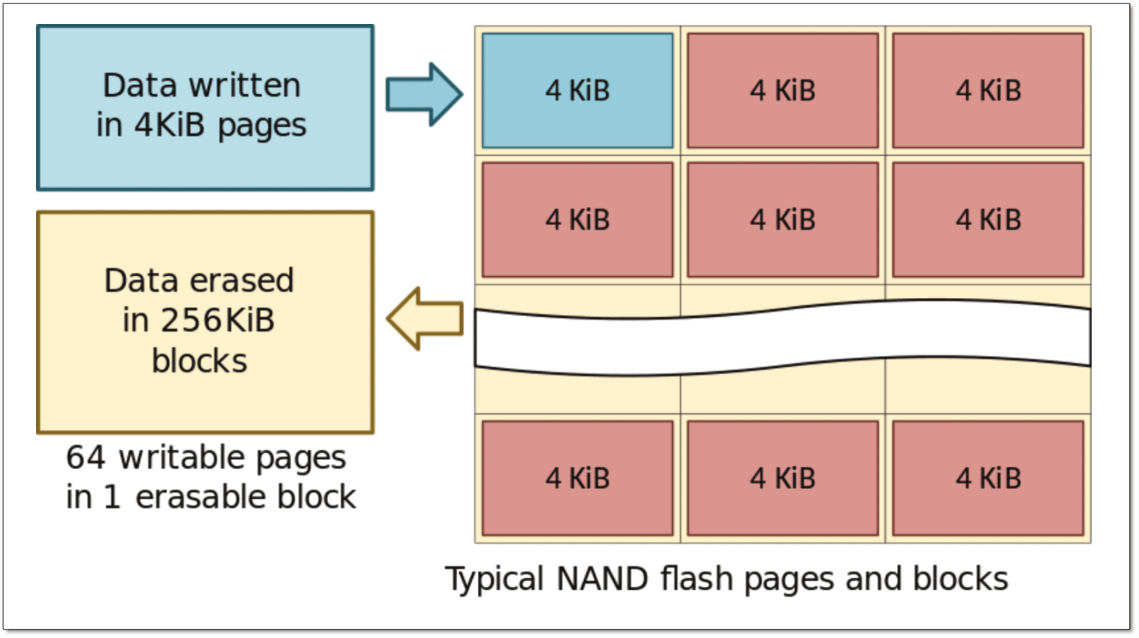
Solid-State Drives
Read/Write in blocks instead of sequentially
Faster than HDD

Slide 9
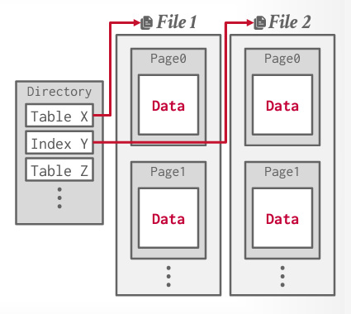
Data Organization on Disks
A table is stored in one or more database files
A file is divided into pages/blocks (minimum unit of data read/write)
A page/block contains a number of records

Slide 10
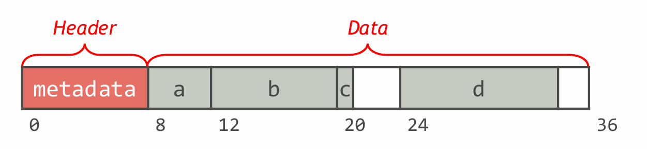
Data Organization on Hard Disk
Header contains the metadata of the record (tuple)
Length of the record, Null value locations, pointer to schema info
Align columns by multiples of 4 or 8 bytes.
CREATE TABLE Foo(
a INT NOT NULL,
b BIGINT NOT NULL,
c CHAR(1) NOT NULL,
d VARCHAR(10) NOT NULL );

Slide 11
Database Page
Each page is a fixed data block (512B-16KB)
Could be larger than OS block size (e.g., Oracle by default uses 8KB vs. 512B OS block)
Each page has a unique page ID in DMBS

Slide 12
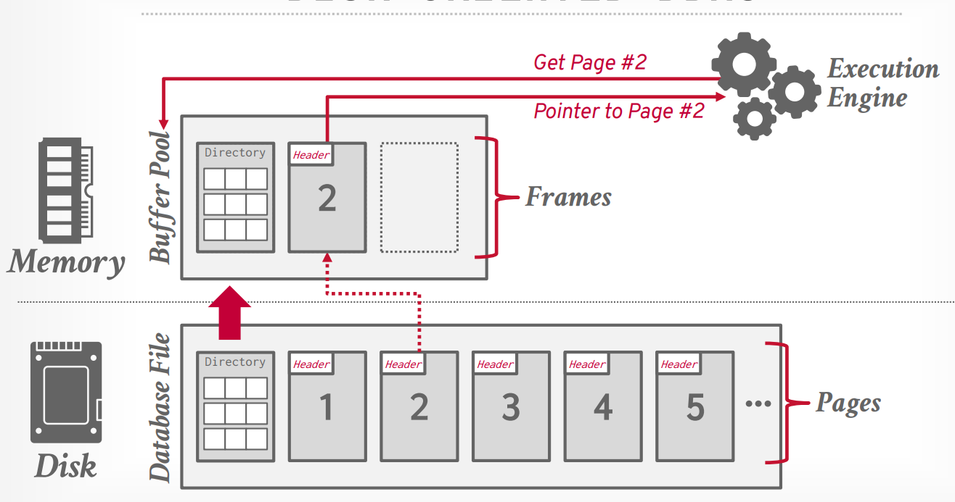
Database Page
Pages need to be loaded into the main memory to process and written back if modified
Buffer management (a separate topic to discuss)

Slide 13
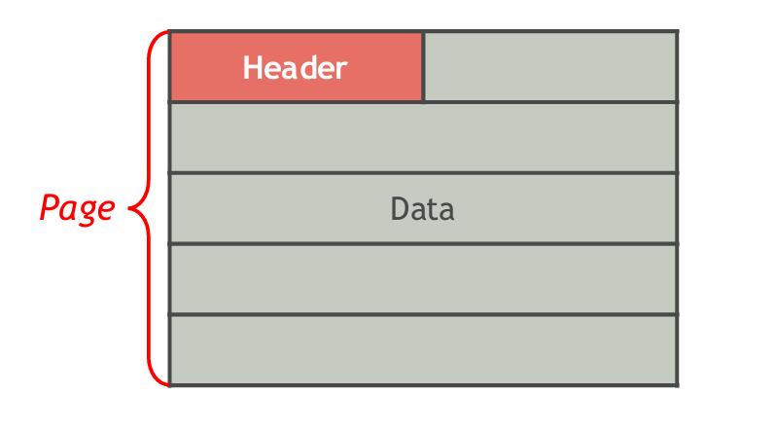
Page Layout
Header info:
Page size
Checksum
DBMS version
Transaction visibility settings
etc

Slide 14
Page Layout
Record layout in a page:
Tuple-oriented
Log-structured

Slide 15
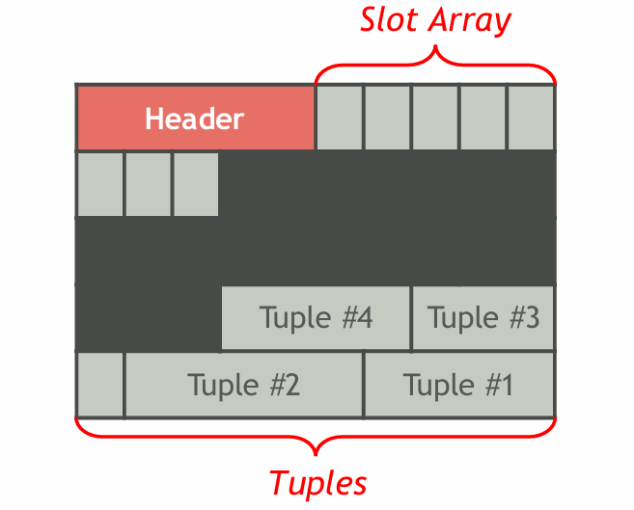
Page Layout
The most common strategy: slotted page
Tuples are added from the end of the page backwards
Slot array keeps track of the position of tuples

Slide 16
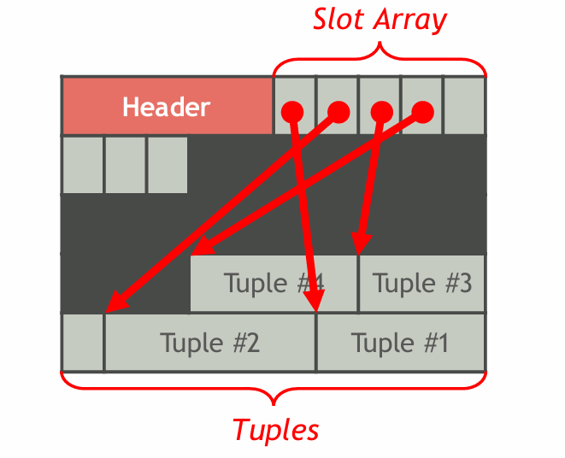
Page Layout
The most common strategy: slotted page
Tuples are added from the end of the page backwards
Slot array keeps track of the position of tuples

Slide 17
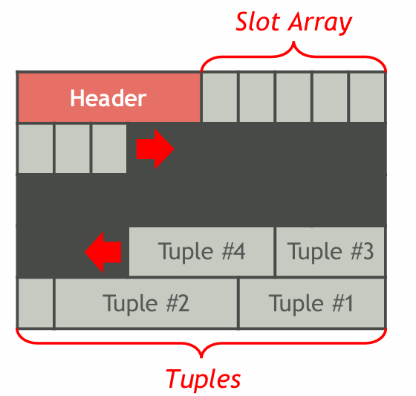
Page Layout
Each tuple is assigned a unique identifier
Most common identifier is a combination of (pageID, SlotID)
Supports tuples with varying lengths

Slide 18
Page Layout
Each tuple is assigned a unique identifier
Most common identifier is a combination of (pageID, SlotID)
Supports tuples with varying lengths
If a tuple is modified and becomes larger, use the original space to store a pointer to the new location of the tuple (can be in another block)
If a tuple is deleted, just remove the pointer
If a tuple is modified and becomes smaller, just leave the unnecessary space empty
For insertion, look for a page with enough free space and compact the page if needed

Slide 19
File Organization on Disk
A file is a piece of disk space used to store records in your tables
How to arrange your records on the disk to improve query efficiency
  Heap file
  Sequential File
  Hash File
  Indexing

Slide 20
Heap File
Pages unordered
Tuples randomly stored in pages
Search/update/delete a tuple requires full search of the file
Organizing Heap files: (1) linked list, (2) page directory

Slide 21
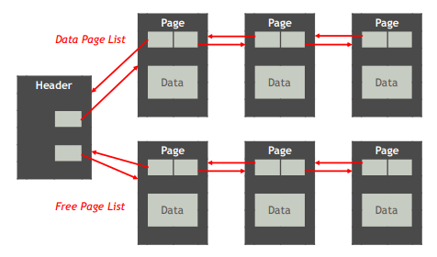
Heap File
Linked list:
A header page with two lists: free pages and data pages
Two-way pointers in head of each page

Slide 22
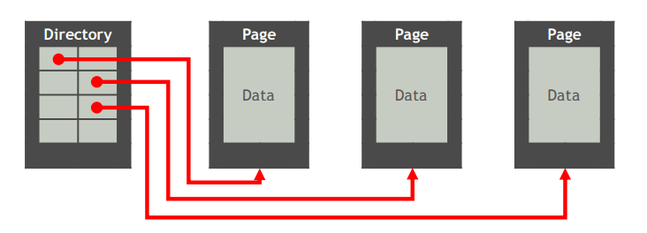
Heap File
Directory:
maintain a directory of every page and their location, their number of free slots
Need to update directory when pages changed.

Slide 23
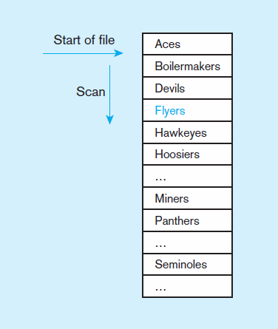
Sequential file organization
1
2
Block 1
Records of the file are stored in sequence by the primary key field values
Block 2
SELECT *
FROM Team
WHERE TeamNickName=‘Hawkeyes’
Block 3
Average number of blocks to load into main memory: N/2, where N = total number of blocks.
Block 4
n

Slide 24
Indexed File Organizations
Indexed File Organization:
  the storage of records with an index that allows software to locate individual records
Index:
  a table or other data structure used to determine in a file the location of records that satisfy some condition
Primary keys are automatically indexed
Other fields or combinations of fields can also be indexed

Slide 25
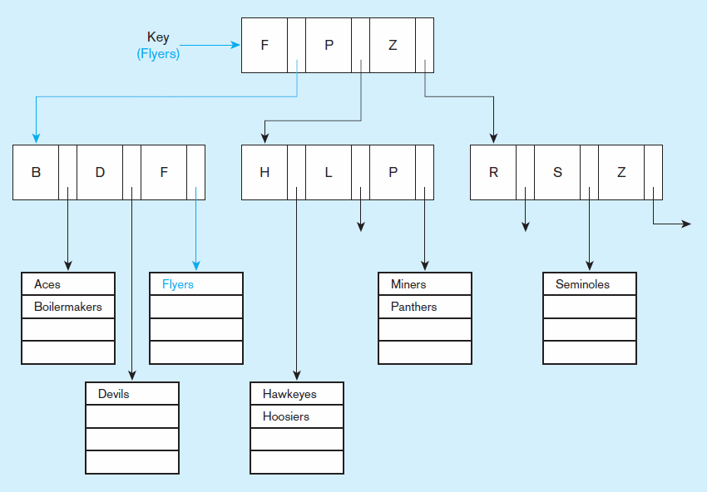
Indexed file organization
uses a tree search
Average time to find desired record = depth of the tree (usually logN)

Slide 26
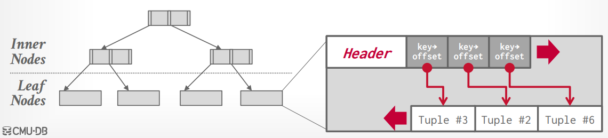
Index-oriented storage
Index structure: Tree-index (B+ tree), Hash Index, others (discussed later)

Slide 27
Rule of Using Index
Use on larger tables
  Indexing takes more storage space
Index the primary key of each table (by default)
Index search fields
  Fields/attributes that frequently appear in WHERE clauses.
    E.g., Name on Facebook
Index fields that often appear in SQL ORDER BY and GROUP BY commands
  E.g., Price, rating on Amazon
Index attributes that have a significant variety in values
  When there are >100 values but not when there are <30 values
… …

Slide 28
The INDEX command in SQL
Example: If there are a large number of queries based on CustomerName, performance would be improved by keeping an index on CustomerName.
Create index
CREATE INDEX NameIDX ON Customer_T(CustomerName);
Delete index
DROP INDEX NameIDX;

Slide 29
Hash File Organization
The physical address of a record is determined by a hash algorithm
Hash algorithm
  Used when storing the record and retrieving the record.
  Input: values of the column you want to build hash for
  Output: the location/address of a record
  When the input is the same, the output has to be the same
  When the input is different, the output has to be different
    Need special mechanism to avoid conflicts.

Slide 30
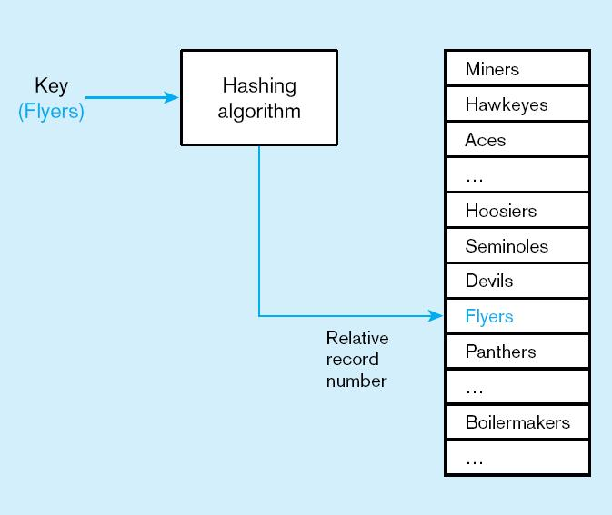
Hashed file organization
Hash algorithm
Hash algorithm is used to determine record position. Records with same position are grouped in lists.
Notes:
Input is key, output is position. A record’s storage position is determined by hash function when the record is inserted

Slide 31
Comparison of Data Access Methods
Factor | Sequential | (tree) Indexed | Hashed
Storage Space | No wasted space | Extra space for index | May need extra space for insertion and deletion
Sequential Retrieval | Vary fast | Moderately fast | Impractical
Random Retrieval on PK | Impractical | Moderately fast | Very fast
Multiple-key retrieval | Possible but need to scan whole file | Vary fast with multiple indexes | Not possible
Deleting Records | Can create waste space or need reorganizing | Easy but need maintenance and space allocation | Very easy
Adding new records | Require rewriting a file | Easy but need maintenance and space allocation | Very easy but may need to handle overflow
Updating records | Usually need to rewrite the file | Easy but need maintenance | Very easy

